Slide 1
Nissan Aggregator Architecture

Slide 2
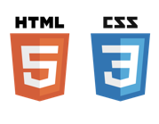






Nissan Aggregator Component Architecture
Command and Control- Deployment Diagram
Browser
Data Agent
<HTTPS>:REST:443
Scheduled Jobs
Web Server
Orchestrator APIs
Web Service layer
<HTTPS>:REST:443
Authorization
Business layer
Authentication
Assessment
Repository layer
<HTTPS>:REST:443
API Server
SMTP:25
Service Now
Sharepoint Metadata
Mail Server
User
Assessment
<HTTPS>:REST:443
Database Server

Slide 3
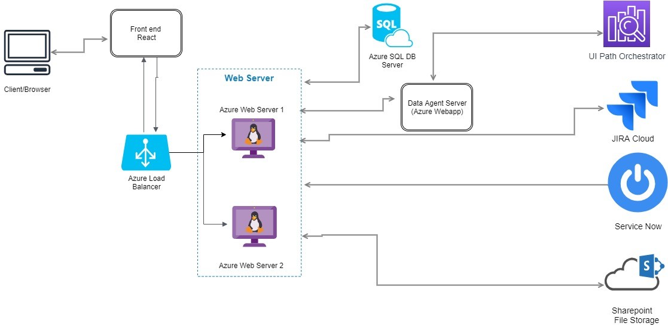
Nissan Aggregator - PaaS based Deployment Architecture

Slide 4
Nissan Aggregator– Application Security Aspects
Web Application
Password Policy
SHA512 Password hashing
TLS 1.2 Network Security
HTTPS Secured communication
Middleware application
Bcrypt Password Hashing
Audit & Logging
TLS 1.2 Network Security
OAUTH 2.0 Authorization protocol
HTTPS Secured communication
Azure Key-Vault
Private VPN
Firewalls
Data backup

Slide 5
Nissan Aggregator- Deployment Options
Artifact | Location | IaaS | Azure PaaS
Web Server | Genpact/Customer Cloud | A2 ( 2 Core, 3.5 GB Ram, 60 GB storage, Linux, CentOS) | Web App Standard Plan
Database Server | Genpact/Customer Cloud |  | Azure SQL Service
Data Agent | Genpact/Customer Cloud |  | Web App Standard Plan

Slide 6
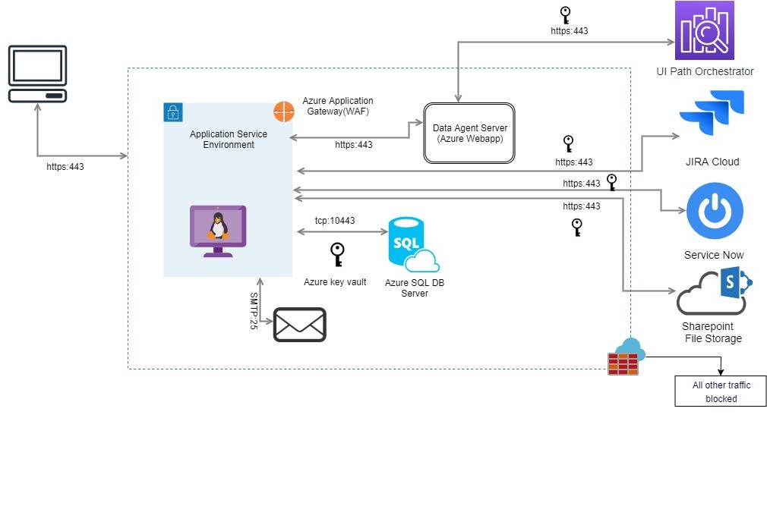
Nissan Aggregator– IaaS Infra security architecture diagram

Slide 7
Appendix

Slide 8
Thank You

